Slide 1

CS5542 Lecture 3
Natural Language Processing (NLP)
References:
Jurafsky, Dan, and James H. Martin. Speech & language processing. Pearson Education India, 2000.
Text Analytics: Natural Language Processing in the Era of Big Data
http://blog.pivotal.io/data-science-pivotal/products/3-key-capabilities-necessary-for-text-analytics-natural-language-processing-in-the-era-of-big-data
Raymond J. Mooney, Natural Language Processing Introduction

Slide 2
NLP

Slide 3
Text Processing Tasks & APIs
Text Processing Tasks
Key phrase extraction
Sentiment analysis
Text analysis
Entity recognition
Translation
Language detection
Topic modeling
Text Processing APIs
Amazon Comprehend;
IBM Watson Natural Language Understanding;
Microsoft Azure (Text analytics API);
Google Cloud Natural Language;
Microsoft Azure (Linguistic Analysis API) - beta;
Google Translate API;
IBM Watson Translator;
Amazon Translate;
Microsoft Azure Translator Text API.
Reference: https://www.kdnuggets.com/2018/08/comparison-most-useful-text-processing-apis.html

Slide 4
Natural Language Processing
NLP is the branch of computer science focused on developing systems that allow computers to communicate with people using everyday language.
Also called Computational Linguistics
Also concerns how computational methods can aid the understanding of human language

Slide 5
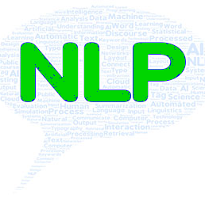
NLP
Natural language processing (NLP) is a field of artificial intelligence in which computers analyze, understand, and derive meaning from human language in a smart and useful way.
By utilizing NLP, developers can organize and structure knowledge to perform tasks such as automatic summarization, translation, named entity recognition, relationship extraction, sentiment analysis, speech recognition, and topic segmentation.
NLP considers the hierarchical structure of language: several words make a phrase, several phrases make a sentence and, ultimately, sentences convey ideas

Slide 6
Challenges Faced by NLP
NLP is characterized as a difficult problem in computer science.
Human language is rarely precise, or plainly spoken. To understand human language is to understand not only the words, but the concepts and how they’re linked together to create meaning.
Despite language being one of the easiest things for the human mind to learn, the ambiguity of language is what makes natural language processing a difficult problem for computers to master.

Slide 7
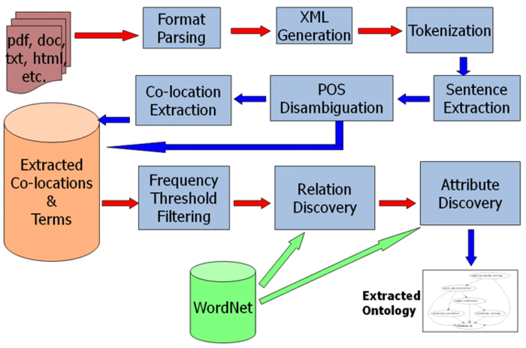
Natural Language Process (NLP)/Information Retrieval (IR) Example: Toolkit for Agent-based Knowledge Extraction (TAKE™)
In corpus linguistics, part-of-speech tagging (POS tagging) is the process of marking up a word in a text (corpus) as corresponding to a particular part of speech, based on both its definition, as well as its context—i.e. relationship with adjacent and related words in a phrase, sentence, or paragraph.
http://www3.kbsi.com/Research/TAKE.htm

Slide 8

WordNet
WordNet is a large lexical database of English.
Nouns, verbs, adjectives and adverbs are grouped into sets of cognitive synonyms (synsets), each expressing a distinct concept.
Synsets are interlinked by means of conceptual-semantic and lexical relations.
The resulting network of meaningfully related words and concepts
In short, WordNet is a database of English words that are linked together by their semantic relationships. It is like a supercharged dictionary/thesaurus with a graph structure.
WordNet's structure makes it a useful tool for computational linguistics and natural language processing.

Slide 9
Project Domains: Structured vs. Textual Data
Structured: Restaurant, Air or Train Travel Schedules, Tourist Information
Textual: Wikipedia, User Reviews, Twitter, Online Chat
Processing unstructured data for backend requires some NLP “smarts”
But data dynamically processed, up-to-date without ongoing maintenance
Potentially much harder to make interaction and presentation of information “smart”

Slide 10
Roots of Question Answering
Natural Language Processing (NLP)
Information Retrieval (IR)
Information Extraction (IE)
Machine Learning (ML)
Dialog Management (DM)

Slide 11
Traditional NLP Workflow
Sentence
Segmentation
Tokenization
Stemming
Part-of-Speech
Tagging
Parsing
Name Entity
Recognition
Co-reference
Resolution
Sentence segmentation identifies where one sentence ends and another begins. Punctuation often marks
sentence boundaries, but as the example in the table shows, there are many exceptions in the usage of language. The construct He said: “Hi! What’s up—Mr. President?” can be viewed as a single sentence.
Tokenization is the process of identifying individual words, numbers, and other single coherent constructs.
Hashtags in Twitter feeds are example of constructs consisting of special and alphanumeric characters
that should be treated as one coherent token. Languages such as Chinese and Japanese do not specifically delimit individual words in a sentence, complicating the task of tokenization.
Stemming strips the ‘ending’ of words. This process is often used by search engines to retrieve documents on ‘greatest hits’ regardless of whether a user searches for ‘greatest hit’ or ‘great hits.’
http://blog.pivotal.io/data-science-pivotal/products/3-key-capabilities-necessary-for-text-analytics-natural-language-processing-in-the-era-of-big-data

Slide 12
Traditional NLP Workflow
Sentence
Segmentation
Tokenization
Stemming
Part-of-Speech
Tagging
Parsing
Name Entity
Recognition
Co-reference
Resolution
Part-of-Speech (PoS) tagging assigns each word in a sentence its respective part of speech such as a verb, noun, or adjective. A commonly used set of PoS tags can be found in the Penn Treebank Tag-set, and the example in the table above uses this tag set. PoS tagging is capable of discerning that the first and second ‘bank’ in the sentence “I bank all my money I earn at the bank”, refer to a verb and noun, respectively.
Parsing derives the syntactic structure of a sentence. The example in the table facilitates the conclusion that
‘John and Frank’ are to be treated as conjunctive noun phrase (NP) and that both of them were involved in the action ‘went.’
Named entity recognition identifies entities such as persons, locations, and times within documents.
Co-reference Resolution: language commonly makes use of references such as ‘he, she, it, them, …’
instead of using the fully qualified entity. Reference resolution attempts to identify multiple mentions of an entity in a sentence or document and marks them as the same instance.
http://blog.pivotal.io/data-science-pivotal/products/3-key-capabilities-necessary-for-text-analytics-natural-language-processing-in-the-era-of-big-data

Slide 13
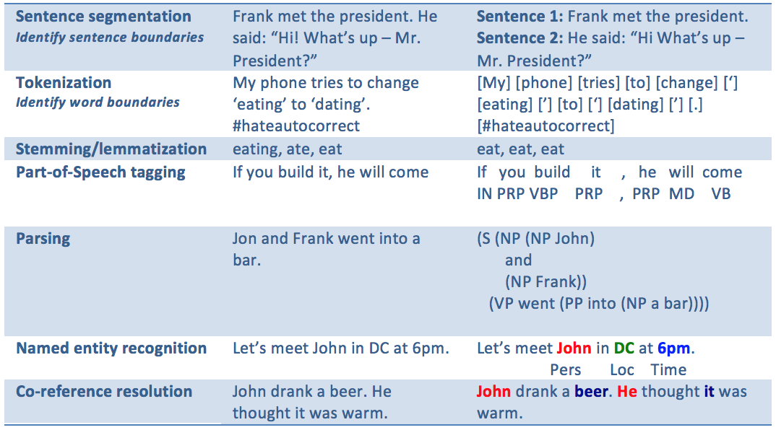
NLP Processing (Example)
http://blog.pivotal.io/data-science-pivotal/products/3-key-capabilities-necessary-for-text-analytics-natural-language-processing-in-the-era-of-big-data

Slide 14
Sentence Segmentation
Sentence boundary detection
Breaking a paragraph into a sequence of sentences.
Segment sentences if the marker is followed by an upper-case letter
/[.!?]\s+[A-Z]/
Special cases: abbreviations, digits, lower-case proper nouns (genes, “amnesty international”, …), hyphens, quotation marks, …
E.g., Frank met the president. He said: “Hi, What’s up, Mr. President?”

Slide 15
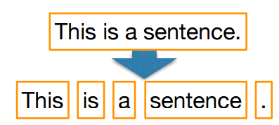
Tokenization
Lexer: converts (“tokenizes”) strings into token sequences
a.k.a.: Tokenizer, Scanner
Tokenization strategies
whitespace (“\s+”) [“PhD.”, “U.S.A.”]
word (letter vs. non-letter) boundary (“\b”) [“PhD”, “.”, “U”, “.”, “S”, “.”, “A”, “.”]
Unicode category-based ([“C”, “3”, “P”, “0”], [“Ph”, “D”, “.”, “U”, “.”, “S”, “.” …])
linguistic ([“that”, “ʼs”]; [“do”, “nʼt”]; [“adjective-like”]; [“PhD”, “.”, “U.S.A”, “.”])
whitespace/newline-preserving ([“This”, “ ”, “is”, “ ”, …]) or not
Task-oriented choice: document classification, entity detection, linguistic analysis, …

Slide 16
Morphological Analysis
Morphology is the field of linguistics that studies the internal structure of words. (Wikipedia)
A morpheme is the smallest linguistic unit that has semantic meaning (Wikipedia)
e.g. “carry”, “pre”, “ed”, “ly”, “s”
Morphological analysis is the task of segmenting a word into its morphemes:
carried ⇒ carry + ed (past tense)
independently ⇒ in + (depend + ent) + ly
Googlers ⇒ (Google + er) + s (plural)
unlockable ⇒ un + (lock + able) ?
⇒ (un + lock) + able ?

Slide 17
Stemming vs. Lemmatization token normalization a.k.a. token “regularization”
Stemming
produced by “stemmers”
produces a word’s “stem”
am ➞ am
the going ➞ the go
having ➞ hav
fast and simple (pattern-based)
Snowball; Lovins; Porter
nltk.stem.*
Lemmatization
produced by “lemmatizers”
produces a word’s “lemma”
am ➞ be
the going ➞ the going
having ➞ have
requires: a dictionary and PoS
LemmaGen; morpha
nltk.stem.wordnet

Slide 18
Part Of Speech (POS) Tagging
Noun: N,
Verb: V,
Adjective: ADJ,
Adverb: ADV,
Preposition: Prep,
Pronoun: Pro,
Determiner: Det
…
Annotate each word in a sentence with a part-of-speech.
Useful for subsequent syntactic parsing and word sense disambiguation.
e.g. the full Penn Treebank PoS tagset contains 48 tags:
34 grammatical tags (i.e., “real” parts-of-speech) for words
one for cardinal numbers (“CD”; i.e., a series of digits)
13 for [mathematical] “SYM” and currency “$” symbols, various types of punctuation, as well as for opening/closing parenthesis and quotes
I ate the spaghetti with meatballs.
Pro V Det N Prep N
John saw the saw and decided to take it to the table.
PN V Det N Con V Part V Pro Prep Det N

Slide 19
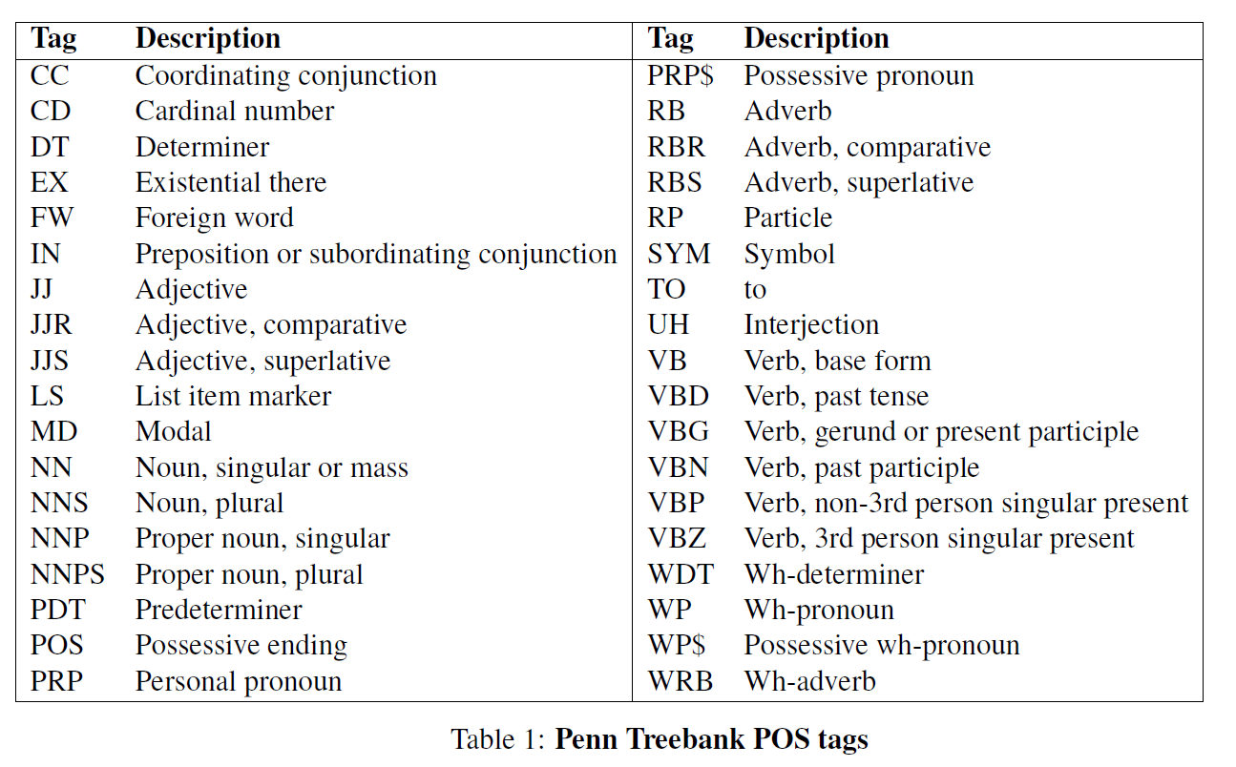

Slide 20
Phrase Chunking
Find all non-recursive noun phrases (NPs) and verb phrases (VPs) in a sentence.
[NP I] [VP ate] [NP the spaghetti] [PP with] [NP meatballs].
[NP He ] [VP reckons ] [NP the current account deficit ] [VP will narrow ] [PP to ] [NP only # 1.8 billion ] [PP in ] [NP September ]

Slide 21
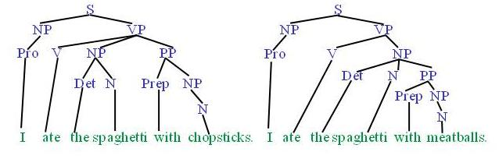
Syntactic Parsing
Produce the correct syntactic parse tree for a sentence.

Slide 22
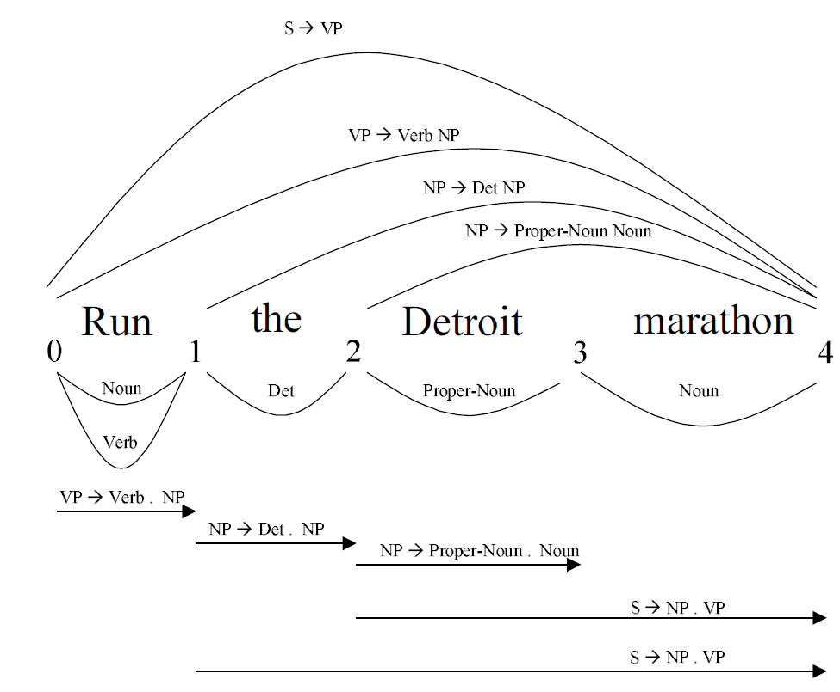
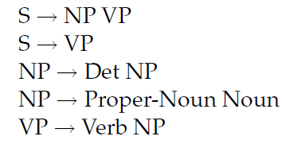
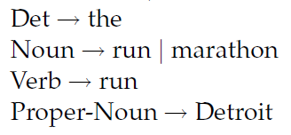
Bottom-up Parsing
“Run the Detroit marathon”
Gramma

Slide 23
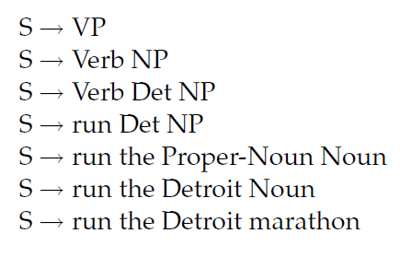
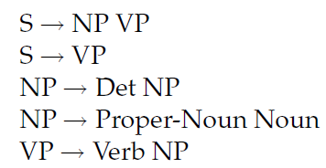
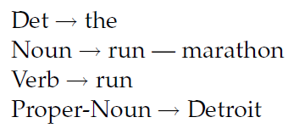
Top-down Parsing
“Run the Detroit marathon”
Gramma
Step 1:
Step 2:
Step 3:
Step 4:
Step 5:
Step 6:
Step 7:

Slide 24
Anaphora Resolution/Co-Reference
Determine which phrases in a document refer to the same underlying entity.
John put the carrot on the plate and ate it.
Bush started the war in Iraq. But the president needed the consent of Congress.
Some cases require difficult reasoning.
Today was Jack's birthday. Penny and Janet went to the store. They were going to get presents. Janet decided to get a kite. "Don't do that," said Penny. "Jack has a kite. He will make you take it back."

Slide 25
Extracting Named Entities
Person: Mr. Hubert J. Smith, Adm. McInnes, Grace Chan
Title: Chairman, Vice President of Technology, Secretary of State
Country: USSR, France, Haiti, Haitian Republic
City: New York, Rome, Paris, Birmingham, Seneca Falls
Province: Kansas, Yorkshire, Uttar Pradesh
Business: GTE Corporation, FreeMarkets Inc., Acme
University: Bryn Mawr College, University of Iowa
Organization: Red Cross, Boys and Girls Club

Slide 26
More Named Entities
Currency: 400 yen, $100, DM 450,000
Linear: 10 feet, 100 miles, 15 centimeters
Area: a square foot, 15 acres
Volume: 6 cubic feet, 100 gallons
Weight: 10 pounds, half a ton, 100 kilos
Duration: 10 day, five minutes, 3 years, a millennium
Frequency: daily, biannually, 5 times, 3 times a day
Speed: 6 miles per hour, 15 feet per second, 5 kph
Age: 3 weeks old, 10-year-old, 50 years of age

Slide 27
How do we extract NEs (Name Entities)?
Heuristics and patterns
Fixed-lists (gazetteers)
Machine Learning approaches
Combinations of WordNet, Wikipedia like
YAGO
DBPedia

Slide 28

Feature Extraction

Slide 29
Feature Extraction
Feature extraction step means to extract and produce feature representations that are appropriate for the type of NLP task you are trying to accomplish and the type of model you are planning to use.
In Text documents feature extraction mainly has two main methods:
bag-of-words,
word embedding.
Both of them are commonly used and has different approaches.

Slide 30
Bag of Words with TF-IDF
Bag-of-Words with TF-IDF is a traditional and simple feature extraction method in natural language processing.
Bag of Words simply counts how many times a word appears in a document.
Bag-of-Words is commonly used in clustering, classification, and topic modeling by weighing special words and relevant terminologies.
TF-IDF(Term Frequency/Inverse Document Frequency) is one of the most popular IR(Information Retrieval) technique to analyze how important a word is in a document.
TF-IDF weighs the importance of words in a document.

Slide 31
Word Embedding
Word embedding is one of the document representation in vector space model.
It captures contexts and semantics of word unlike Bag-of-Words model.
Bag-of-Words only represents number of occurrence of words in document without any relationships and contexts. On the other hand, Word embedding preserves contexts and relationships of words so that it detects similar words more accurately.
Word embedding has several different implementation such as word2vec, GloVe, FastText and etc

Slide 32
Word2Vec
Word2vec is one of the most popular implementation of word embedding
Invented by Google in 2013
It is good at grouping similar words and making highly accurate guesses about meaning of words based on contexts.
It has two different algorithms inside:
Skip Gram is to predict context from target word.
CBoW(Continuous Bag-of-Words) is to predict a target word from context.

Slide 33
Applications

Slide 34
Text Summarization
Produce a short summary of a longer document or article.
Article: With a split decision in the final two primaries and a flurry of superdelegate endorsements, Sen. Barack Obama sealed the Democratic presidential nomination last night after a grueling and history-making campaign against Sen. Hillary Rodham Clinton that will make him the first African American to head a major-party ticket. Before a chanting and cheering audience in St. Paul, Minn., the first-term senator from Illinois savored what once seemed an unlikely outcome to the Democratic race with a nod to the marathon that was ending and to what will be another hard-fought battle, against Sen. John McCain, the presumptive Republican nominee….
Summary: Senator Barack Obama was declared the presumptive Democratic presidential nominee.

Slide 35
Question Answering
Directly answer natural language questions based on information presented in a corpora of textual documents (e.g. the web).
When was Barack Obama born? (factoid)
August 4, 1961
Who was president when Barack Obama was born?
John F. Kennedy
How many presidents have there been since Barack Obama was born?
9

Slide 36
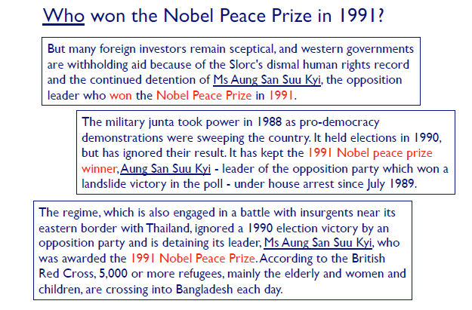
An Example

Slide 37
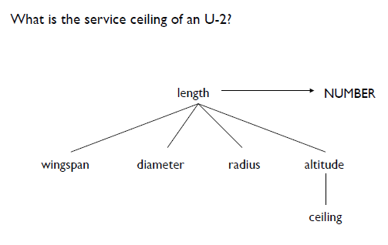
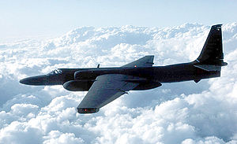
Using WordNet and Wikipedia
This aircraft had a service ceiling of 54,000 feet and numerous encounters between the U-2 and RCAF 'ZULU' alert flights have been recorded for posterity.^{[45]}

Slide 38

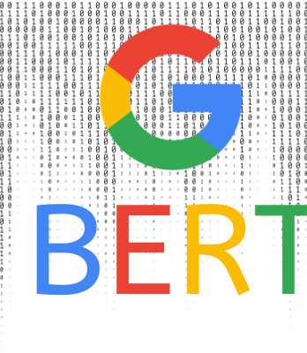
BERT (by Google)
Bidirectional Encoder Representations from Transformers
Open-sourced neural network-based technique for natural language processing (NLP) pre-training
This technology enables anyone to train their own state-of-the-art question answering system.
This breakthrough was the result of Google research on transformers: models that process words in relation to all the other words in a sentence, rather than one-by-one in order.
BERT models can therefore consider the full context of a word by looking at the words that come before and after it—particularly useful for understanding the intent behind search queries.

Slide 39
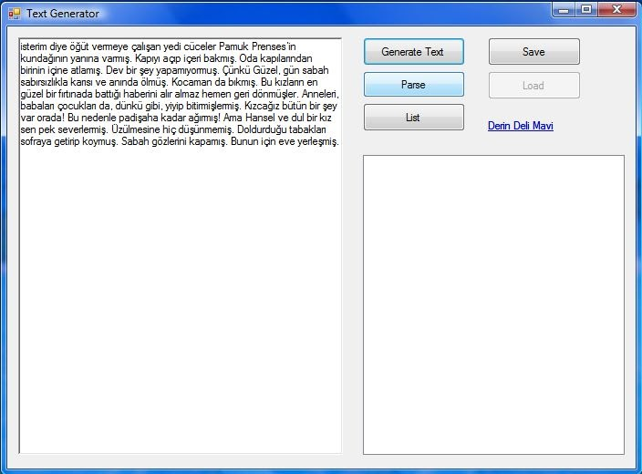
GPT-3 Text Generator
OpenAI’s new language generator GPT-3 is
The AI is the largest language model ever created and can generate amazing human-like text on demand
The predecessor to GPT-3 is GPT-2
The full-sized GPT-3 has 175 billion parameters, where as GPT-2 has 1.5 Billion parameters.
GPT-3 was also matched with a larger dataset for pre-training: 570GB of text compared to 40GB for GPT-2.

Slide 40
5 Heroic NLP Tools in Data science
CoreNLP from Stanford group
NLTK, the most widely-mentioned NLP library for Python
TextBlob, a user-friendly and intuitive NLTK interface
Gensim, a library for document similarity analysis
SpaCy, an industrial-strength NLP library built for performance
Reference : https://towardsdatascience.com/5-heroic-tools-for-natural-language-processing-7f3c1f8fc9f0

Slide 41
